Slide 1
Data Science Final Project
Doron Firman 319091294

Slide 2
Motivation
Enjoyed playing video games since a young age.
Video games provided a distraction and encouraged unique thinking.
Introduced to the Steam platform after getting a computer.
Used Steam as primary gaming platform for around 12 years.
Observed growth and evolution of Steam, including new games and software.
Developed interest in understanding the factors behind game popularity.

Slide 3
What factors influence the peak concurrent users for games or software on the Steam platform?
Business Problem:
Notes:
אני רוצה להבין מה הופך משחק לפופולרי

Slide 4
Introducing Steam
Active Users: Steam has over 120 million monthly active users.
Games Available: The platform offers more than 30,000 games across various genres.
Peak Concurrent Users: The record peak concurrent user count was around 26 million.
Average Playtime: The average playtime for Steam users is approximately 21 hours per week.
Number of Developers: Steam has over 100,000 active developers.
Market Share: Steam holds a significant market share in the PC gaming distribution space, estimated to be over 70%.
Regional Usage: Steam is used by gamers around the world, with a strong presence in North America, Europe, and Asia.

Slide 5
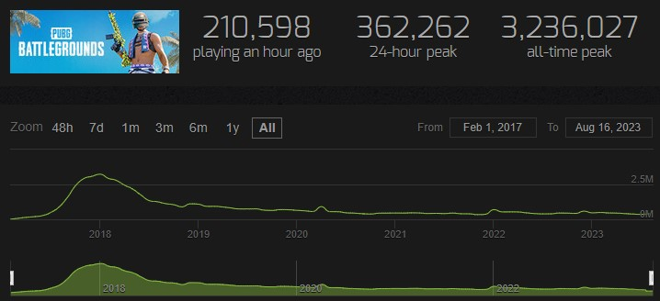
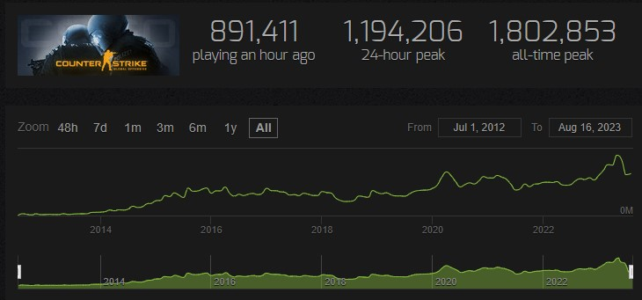
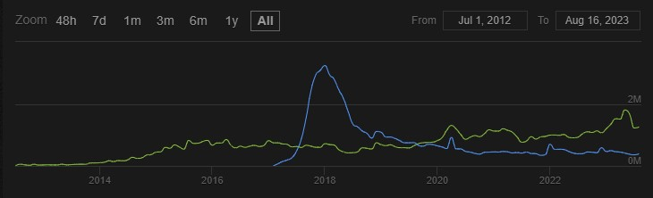
Why Peak Concurrent Users?
Peak concurrent users on Steam = highest users playing a game/software simultaneously
Metric to gauge game/software success/popularity in Steam community
Higher peak users = more successful; larger user base, active engagement
High count shows thriving multiplayer, user retention, visibility
Leads to positive reviews, potential sales growth
*The data was taken from https://steamcharts.com/

Slide 6
Data Review

Slide 7
Data Review
About the dataset:
Kaggle dataset*
Approximately 70k rows and 39 columns
Games and software released between the years 1997 and 2023
Includes English and non-English games and software
*The data was taken from https://www.kaggle.com/datasets/mexwell/steamgames

Slide 8
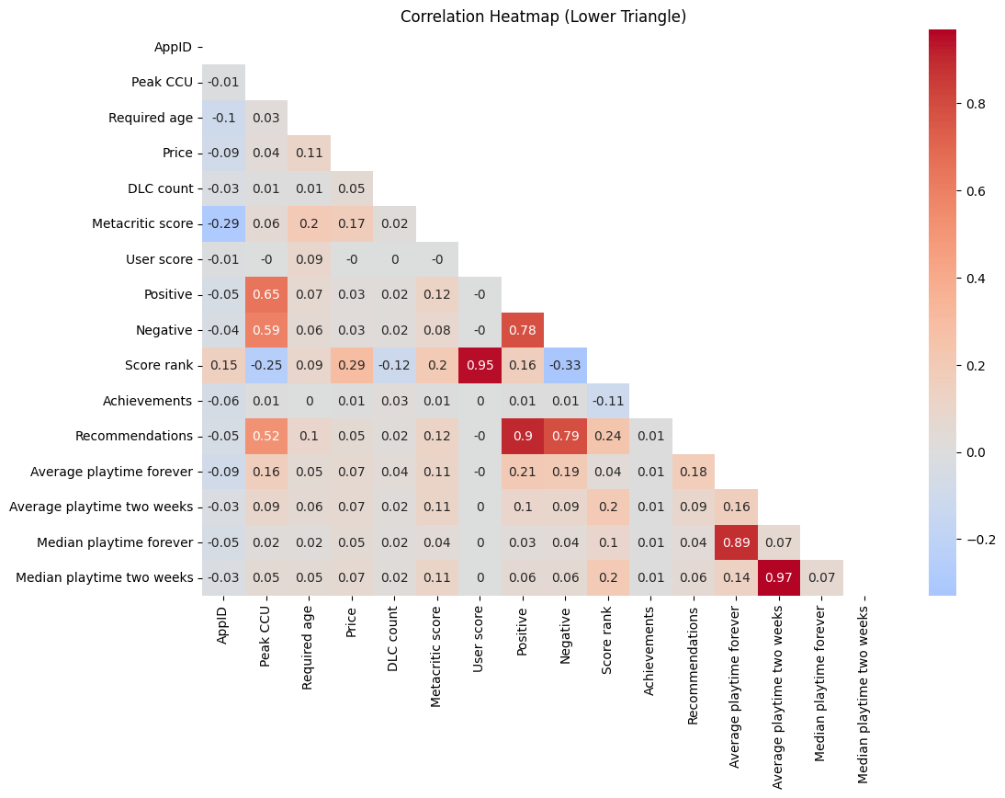
Data Review
Correlation Heatmap:
Higher peak CCU tend to correlate with more positive and negative reviews from users.
A higher Metacritic score is moderately correlated with more positive reviews and less negative reviews.
User scores have a weak correlation with positive and negative reviews.
Higher-priced games and software might correlate with better Metacritic score and positive reviews.
More recommendations are strongly linked with higher positive reviews but also with higher negative reviews.
User scores significantly influence the games/software ranking.
Longer average playtime relates to better positive reviews.
More DLC’s might lead to higher peak CCU.

Slide 9
Data Review
Important columns to note:
Name (str): The name of the game or software
Release date (date): The release date of the game or software
Estimated owners (categorical): A range with the number of owners of a game or platform
Peak CCU (int): The maximal number of users who played the game at the same time
Price (int): The original price of the game or software (in US dollars)
Platform (bool): (Windows\Linux\Mac): Dummy variables that describe which platforms the game or software supports
Scores (int): (Metacritic\Users): The score assigned in a scale of 0-100
Playtime (int): (Average\Median): The number of hours played per user per period
Developers (str): The name of the game studio\s or people who developed the game
Publishers (str): The name of the publisher\s of the game or software
Categories (str): Steam assigned categories
Genres (str): Developer assigned genres
Tags (str): User assigned tags for the game or software

Slide 10
Feature Engineering
New important features to note:
Price range (categorical): The price range of the game
Release by Quarter (categorical): The quarter in which the game or software was released
(#)_Publishers (int): Number of publishers
(#)_Categories (int): Number of categories
(#)_Genres (int): Number of Genres
(#)_Tags (int): Number of tags
Review Ratio (int): The ratio of positive review out of all reviews
Price per (x) playtime (int): The price per hour of use

Slide 11
Label Analysis

Slide 12
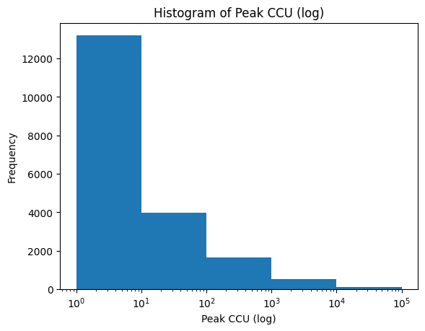
Label Analysis
Peak CCU histogram:
We can see that most gams have a low number of peak CCU
We can also see that it is very rare to have more than 10k peak CCU

Slide 13
Frequency Analysis

Slide 14
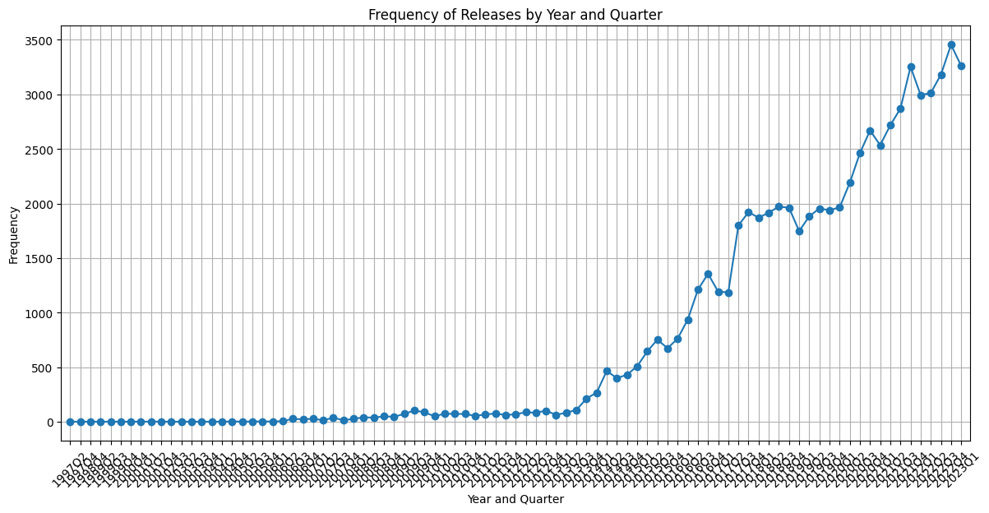
Frequency Analysis
Year and quarter frequency:

Slide 15
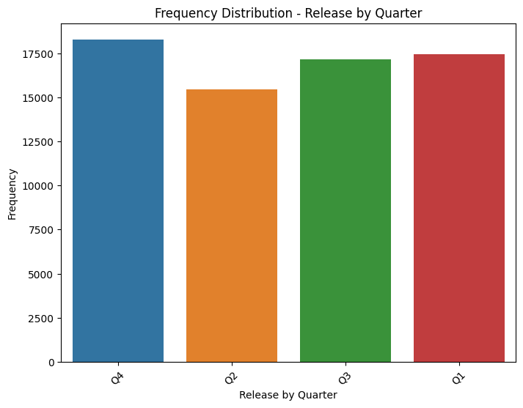
Frequency Analysis
Quarter frequency:
Evenly distributed
Q4 has the most releases
Q2 has the least releases (although 2023 Q2 and onwards is not in the data)

Slide 16
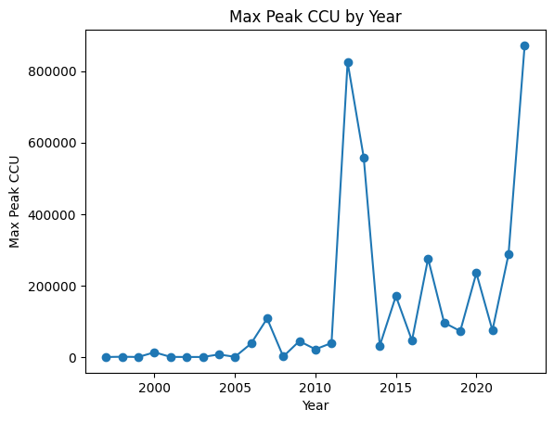
Frequency Analysis
Maximal peak CCU for a game by year:
We can see a gradual increase over the years
On average excluding 2012, 2013 and 2023 we can expect the maximal peak CCU to be at around 200K-300K

Slide 17
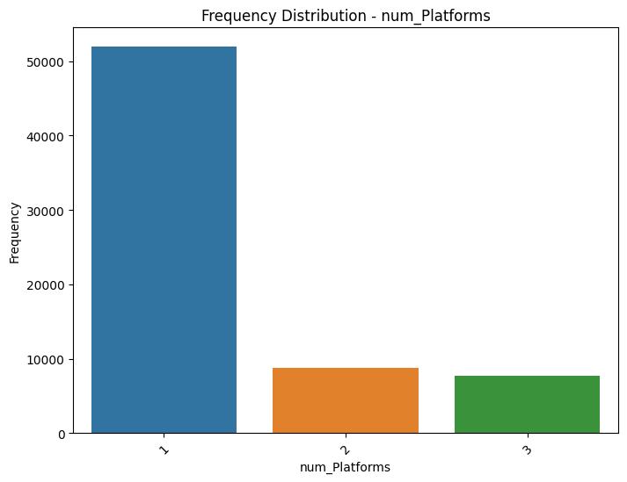
Frequency Analysis
Frequency distribution of (#) of platforms
We can see most games support a single operating system
We can also see that the number of games supporting 2 and 3 operating systems are relatively equal

Slide 18
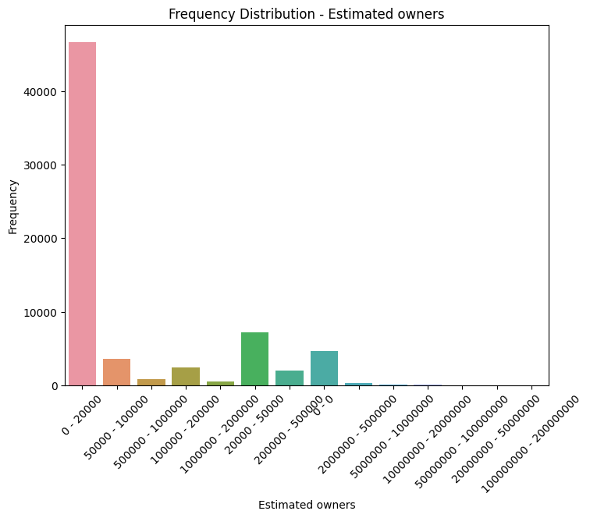
Frequency Analysis
Frequency distribution of estimated owners
We can see that most of the game have between 1-20k owners
We can also see that having above 500k owners is rare with less than 5% of the games

Slide 19
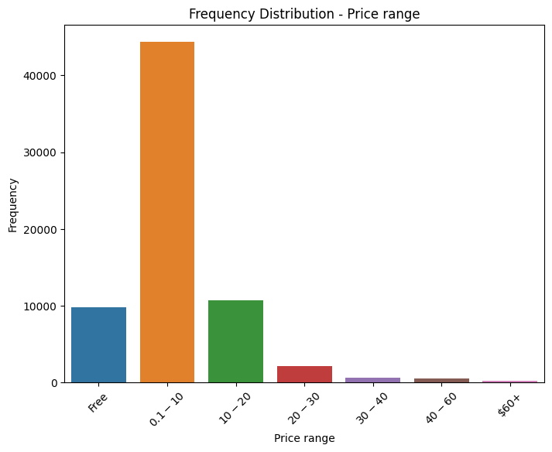
Frequency Analysis
Frequency distribution of price range
We can see that most of the game are priced between 0.1-10 USD
We can also see that having a price above 20 USD is rare with less than 5% of the games

Slide 20
Dummy Variables

Slide 21
Dummy Variables
Top n values:
For this part I wanted to see if specific categories, tags and genres impact the peak CCU. Since there are many entries for each column, I chose to focus on the values that appeared the most. I decided at first to create a cutoff of 20 and based on the results I tweaked the number for each one (relevant graphs appear in the accompanying word document). Regarding the ones that didn’t make the cutoff I grouped them into a value named ‘other’ which is visualized as well.
Following that I have created dummy variables for the top ‘n’ entries and the ‘other’ as well and added them into the data.

Slide 22
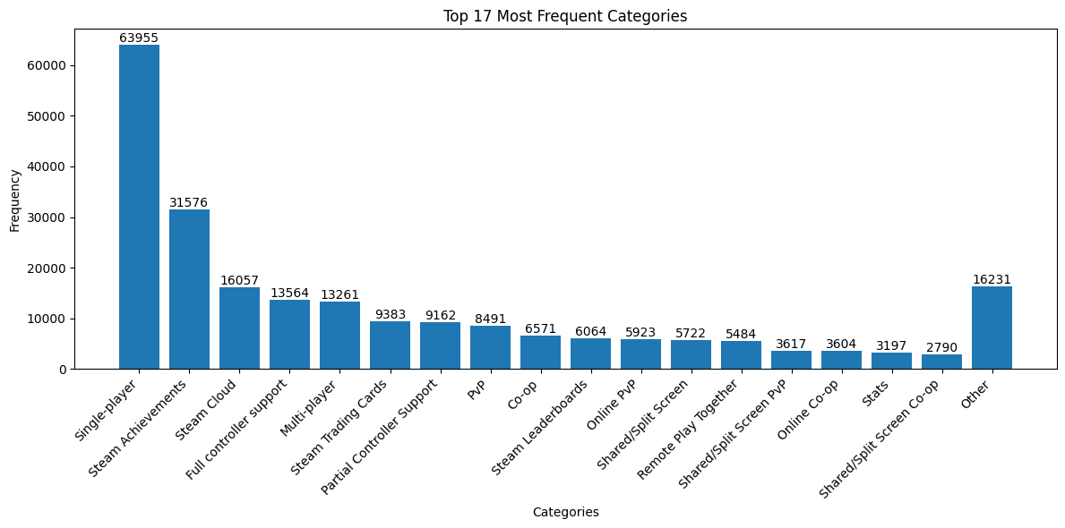
Dummy Variables
Top Categories
We can see that “single-player” is the biggest category
Every category which appeared less than roughly 5% was joined together into the ‘Other’ category
Notes:
Analyzing impact of categories, tags, genres on peak CCU.
Focused on most frequently appearing values in columns.
Set initial cutoff at 20, adjusted based on results.
Graphs in accompanying document show results.
Grouped values below cutoff as 'other', visually represented.
Created dummy variables for top entries and 'other'.
Added dummy variables to the dataset

Slide 23
Outlier Detection

Slide 24
Outlier Detection
Assumptions:
For this part I used IQR Visualization which means Box Plot with IQR-based Thresholds
Assumed that the data has a skewed distribution.
Assumed that the interquartile range (IQR) is a robust measure of spread.
Assumed that outliers can be identified based on being below Q1 - 1.5 * IQR or above Q3 + 1.5 * IQR.

Slide 25
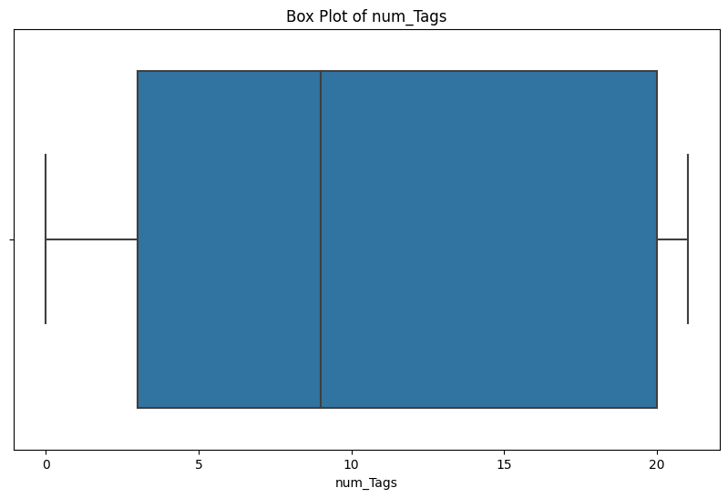
Outlier Detection
Outlier detection of number of tags
We can see that most of the values are between 3-20 tags
We can also see that the average value is about 9 tags per game or software

Slide 26
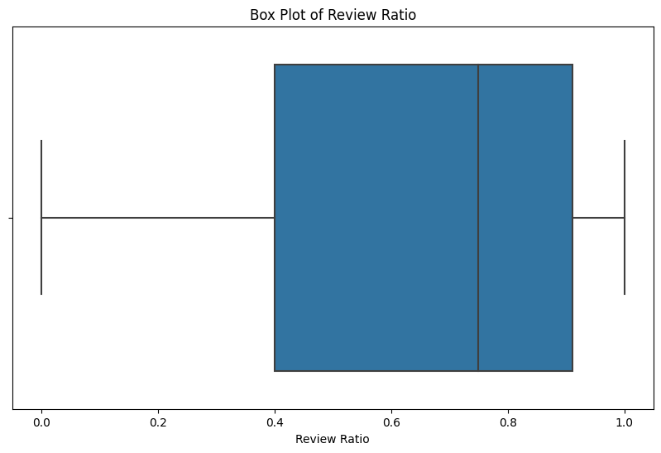
Outlier Detection
Outlier detection of number of tags
We can that most of the ratios lie between 0.4-0.9 with the average ratio at about 0.7 per game or software
This tells us that in general most games have more positive reviews than negative

Slide 27
Model Training

Slide 28
Testing and Training
The Models:
For this part I chose to use 4 models which are:
Linear Regression
Lasso
Random Forest
xGradiant Boosting
I measured the performance of each model based on the following criteria: R- square, MSE, R-MSE and MAE

Slide 29
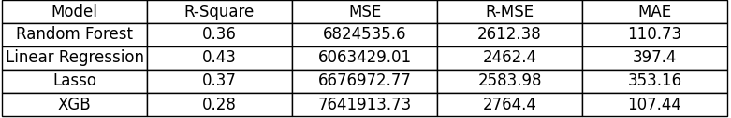
Testing and Training
Model Performance Results:
We can see from the results that RF and xGB performed quite well with xGB being a bit better.

Slide 30
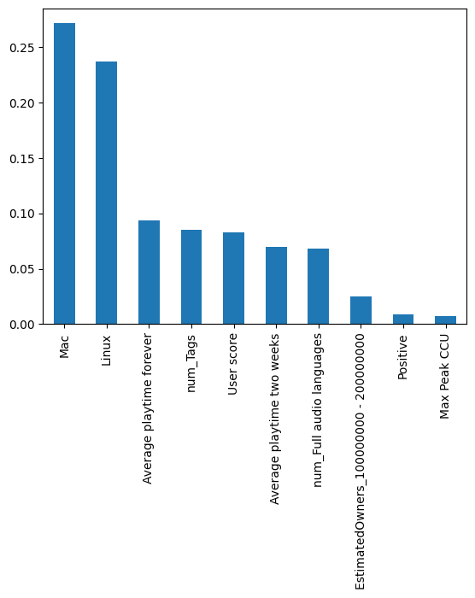
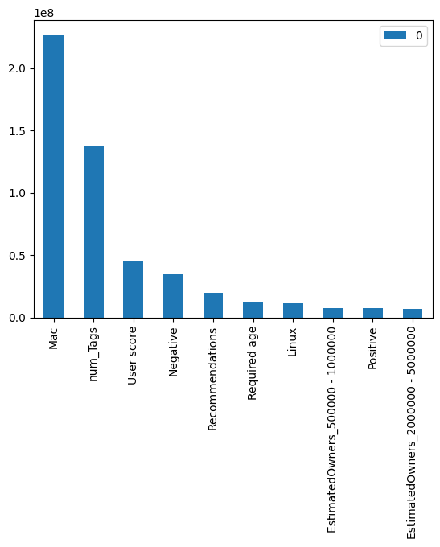
Testing and Training
Feature Importances:
Random Forest – Feature Importances
xGradiant Boosting– Feature Importances
We can see that in both models we get mostly the same features
For both cases it seems that supporting Mac increases the prediction rate
All in all, I believe that the features appearing here are very logical because implementing these features allows for a greater target market or imply a high number of users

Slide 31
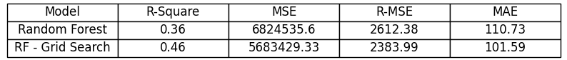
Testing and Training
Model Improvement:
For this part I chose to take the RF model (due to time concerns) and try to improve its results using grid search.
I then used the same metrics and compared both models.
We can see the big improvement which yields the best overall results compared to all the previous models

Slide 32
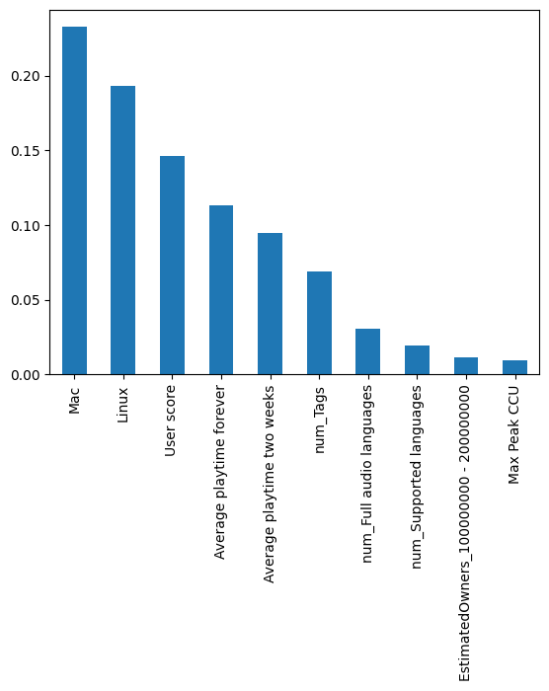
Testing and Training
Feature Importances:
Random Forest – Feature Importances
RF Grid Search– Feature Importances
We can see that in both models we get mostly the same features
The only visible change is between positive and number of supported languages
What seems surprising to me is that user reviews have much less effect than one might think
What is unsurprising is that quarter of release is non apparent at all

Slide 33
PCA and Clustering

Slide 34
PCA and Clustering
The Process:
For this part I used the following:
PCA reduction to 2-dimensions
Elbow function and silhouette score to determine optimal number of clusters
Clustering of all the games and platforms
Notes:
אני מוצא את הקלאסטרים באמצעות pca ואז משתמש בפיטצרים המקוריים על כל קלאסטר

Slide 35
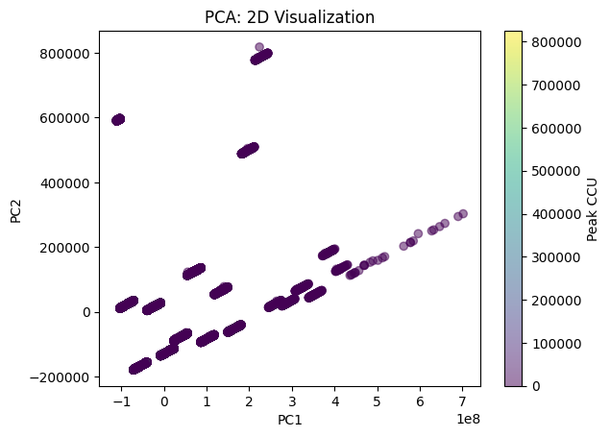
PCA and Clustering
PCA
We can see that there is a positive correlation between PC1 and PC2
We can also see that there are two clusters of data points, one at the bottom left and one at the middle right

Slide 36
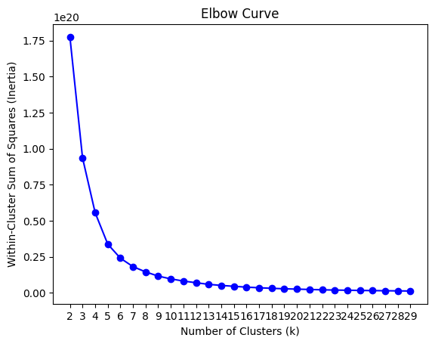
PCA and Clustering
Elbow Function
We can see that for the following elbow function it is hard to determine what is the optimal number of clusters
Using silhouette score I found that 28 clusters has the minimal value

Slide 37
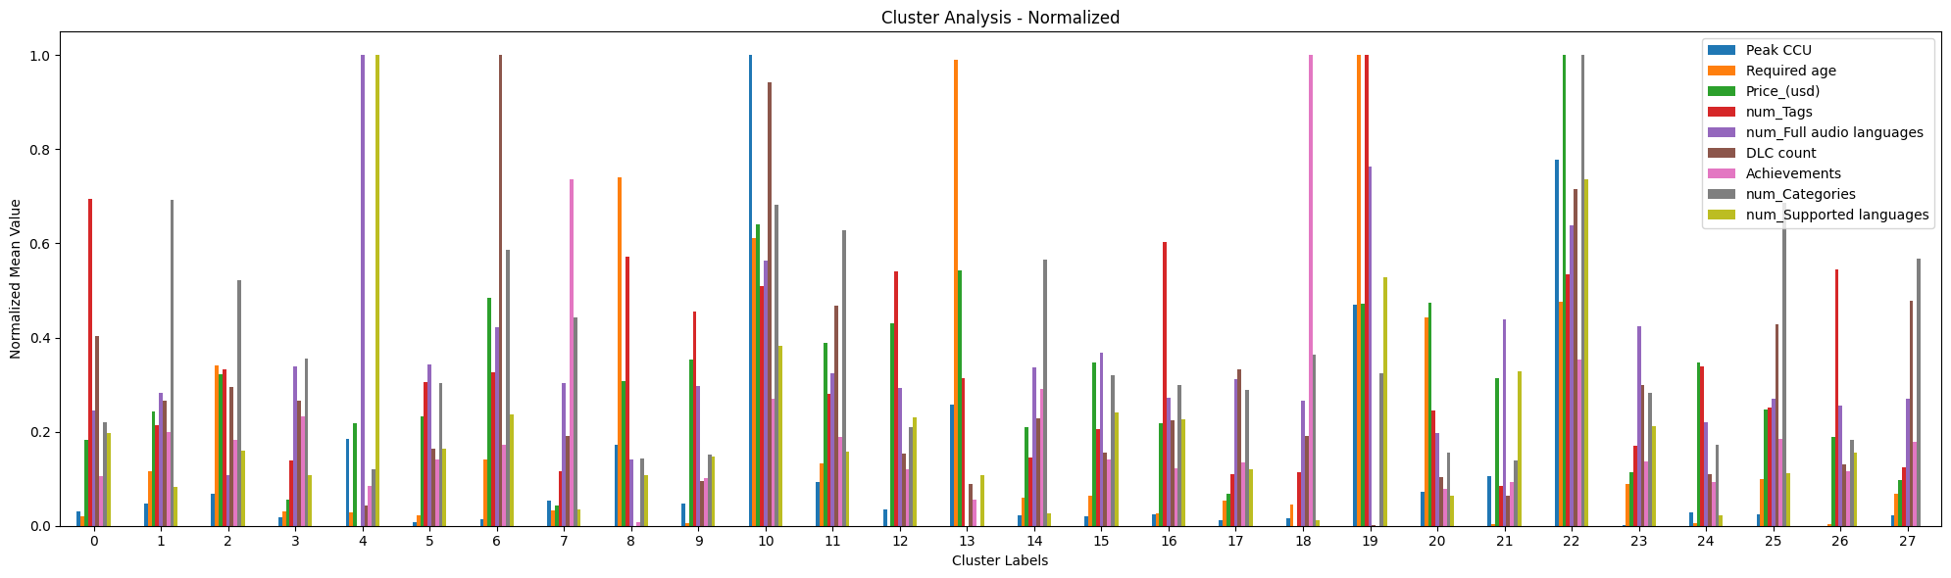
PCA and Clustering
Clustering

Slide 38
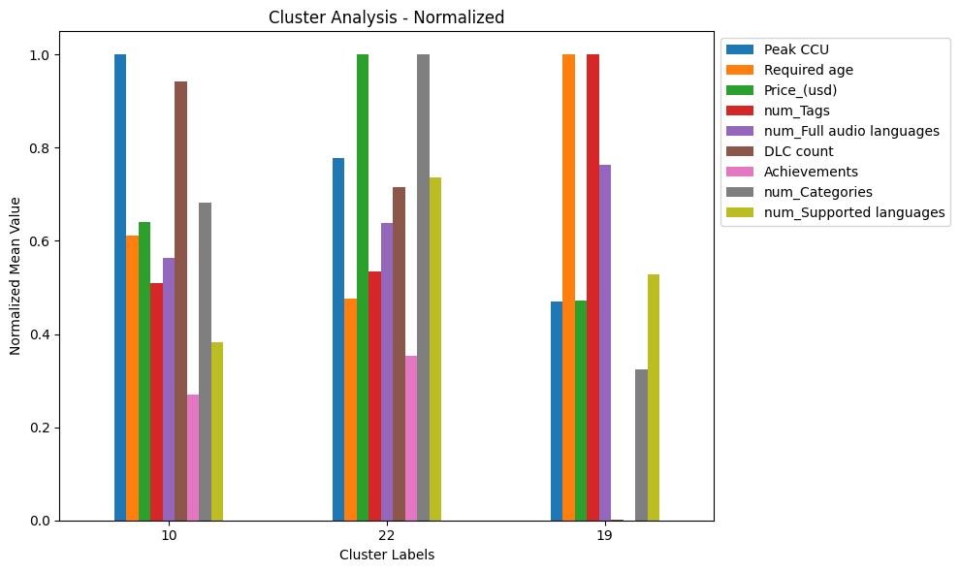
PCA and Clustering
Clustering Motivation:
For this part I wanted to see how developers can try and manipulate the peak CCU before releasing the game
We can see 3 clusters with the highest peak CCU which are 10, 22 and 19

Slide 39
PCA and Clustering
Clustering Conclusions:
Games and software in these clusters tend to have relatively high values for almost all the chosen features, with the exception being “Achievements”. Specific features that are lower include “num_Categories” and “DLC_count” for cluster 19

Slide 40
Conclusions

Slide 41
Conclusions
Conclusions:
The project focused on analyzing factors affecting peak CCU on Steam for games/software.
Aims to guide developers on achieving higher peak CCU.
Findings from analysis:
Publishing for Mac and Linux has significant positive impact.
More tags, higher user rating, and more reviews correlate with higher peak CCU.
Increasing supported languages and audio has positive influence.
Post-release support through DLC contributes to higher peak CCU.
Supporting additional platforms requires increased investment, impacting costs.
Suggests that being a AAA game or software could encompass and cover various identified factors.

Slide 42
Further Research

Slide 43
Further Research
Further Research:
Future projects could involve integrating current data with data from other platforms (e.g., Uplay, Origin, GOG, Epic Games Store). Aims to enhance accuracy and confirm research conclusions across multiple platforms.
Another approach could be integrating data from console sales for broader insights.
Potential inclusion of HLTB (How Long To Beat) database, offering "real" game length based on player time. HLTB data might reveal new insights and provide additional information for analysis.

Slide 44
Thank You

